Slide 1
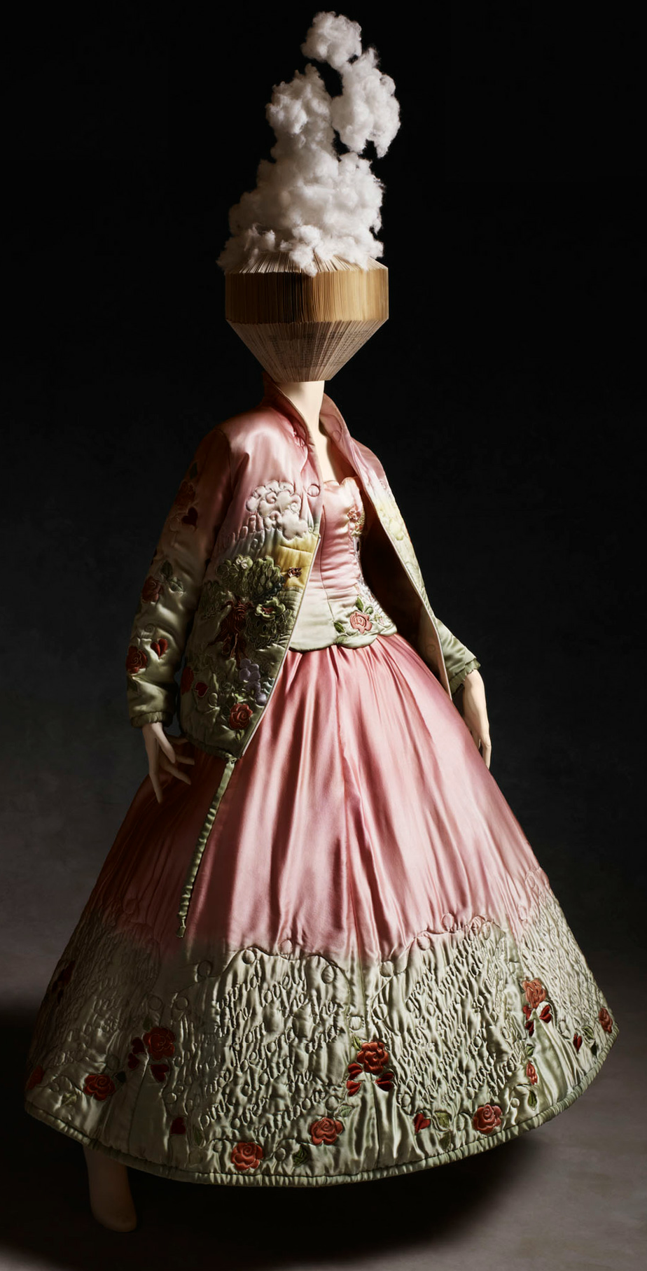
Fashion and fairytale
PARTNER PACK

Slide 2
Fashion and fairytale’s aims
Fashion & Fairytale is ambitious.
We aim to have impact on a social and environmental scale.
We believe that by educating students of all abilities, we can inspire a new generation of designers that challenge the status quo, question buying habits and put sustainability at the heart of their creativity.
Thereby future proofing the fashion industry and preserving the natural environment for generations to come.

Slide 3
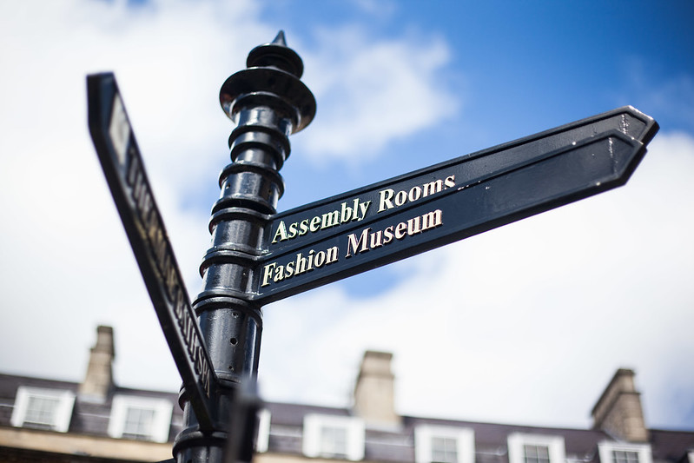
Fashion and Fairytale draws on Bath's sTyle heritage to inspire the creative energy of the city's community.
Bringing together the skills of businesses, craftspeople, designers, artists and the imaginations of local children and students, Fashion and Fairytale offers a unique opportunity for your business to tailor sponsorship to your marketing and corporate responsibility objectives.
​

Slide 4
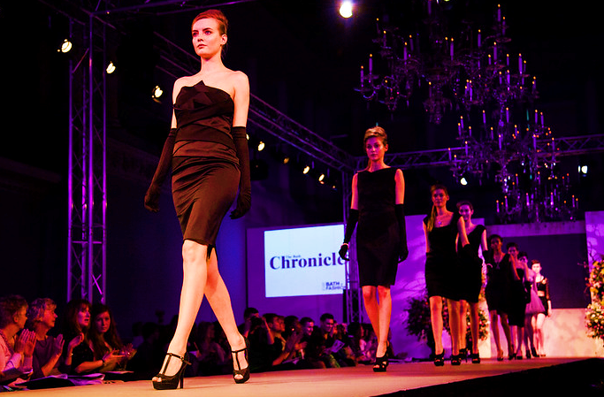
YOUR BRAND: SPONSORSHIP OF FASHION AND FAIRYTALE events OFFERS A POWERFUL ASSOCIATION FOR THE NICHOLAS WYLDE BRAND
Credit: Bath in Fashion
Bath in Fashion attracted a year on year, cumulative online following of nearly 7000 followers.
Fashion and Fairytale has a following of over 350 followers in just 6 weeks. If we continue to grow at this rate, we can conservatively expect to reach over 3000 followers by August 2020.
For more on Bath in Fashion

Slide 5
Fashion and fairytale proposal
Fashion and Fairytales's varied programme of events offers you the chance to engage your target audience in a bespoke, meaningful and rewarding way.
​
As well as a strong brand association, with numerous opportunities to link your brand in print, online and advertising, you are nurturing a new generation of creatives and designers and kickstarting a wider conversation about sustainability.
Partnering with us in this celebration of the imagination offers unlimited opportunities for you to showcase your brand across social media and multimedia PR channels.

Slide 6
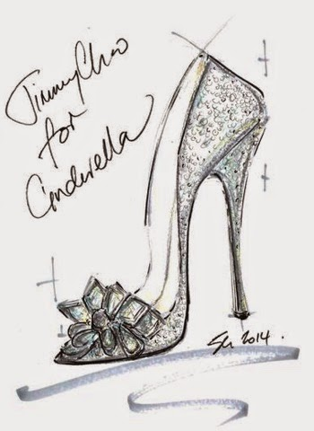
Fashion and Fairytale Partner Options
As a team of Marketing, PR, Social Media experts and writers, we know that one size does not fit all.
​
Choose one, choose a mix or get in touch to create your own brand association.

Slide 7
A BESPOKE PROGRAMME TAILORED TO YOU
SPONSORSHIP: One or more days of the Fashion & Fairytale Exhibition at the Assembly Rooms, Bath from 2nd – 6th August, 2020 POTENTIAL RETURN: A profile of your business on the Fashion & Fairytale website with a link to your website
Personalised promotion of your brand through the Fashion & Fairytale 12 month social media and marketing campaign
Personalised Exhibition Brochure for day(s) of sponsorship
Opportunity to curate a bespoke workshop or event reflecting your brand and business
VIP Invitation to Mentoring Plus Charity Auction & Fashion & Fairytale Gala Fashion Show & Press Event at the Assembly Rooms on 9th July, 2020
​

Slide 8
Fashion and fairytale Timeline
June - July 2019: Online launch of Fashion & Fairytale Exhibition & Competition
​September 2019: all schools and colleges across Bath will receive branded design sheets upon which they can design their own nature inspired outfit
October 2019: Southgate Student event workshops & free half term window display trail showcasing sustainability in the city
December 2019: BANES Christmas workshops & Mentoring Plus Girls’ Group social media upcycling journey
January 31st 2020: competition deadline. Judging begins and four winning designs will be chosen by celebrated craftspeople and Bath designers
February – July 2020: education and partner events. Four winning outfits created in readiness for press launch & Fashion Show Auction in aid of Mentoring Plus on 9th July and Fashion and Fairytale Exhibition, Assembly Rooms from 2nd-6th August.

Slide 9
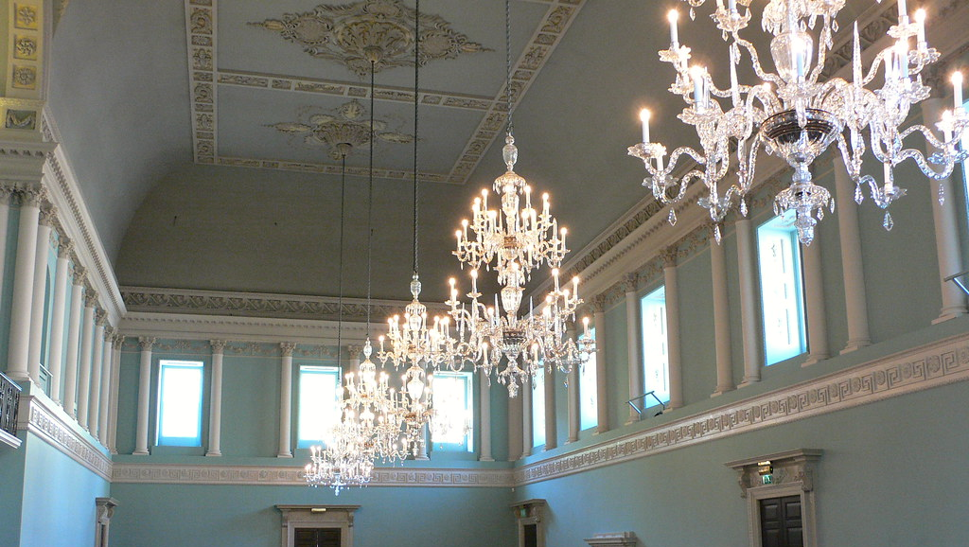
WE LOOK FORWARD TO WORKING WITH YOU DURING FASHION & FAIRYTALE 2019-2020
Katy Hancock Marketing & PR fashionandfairytale@gmail.com 07970 036 979
​
.

